Slide 1
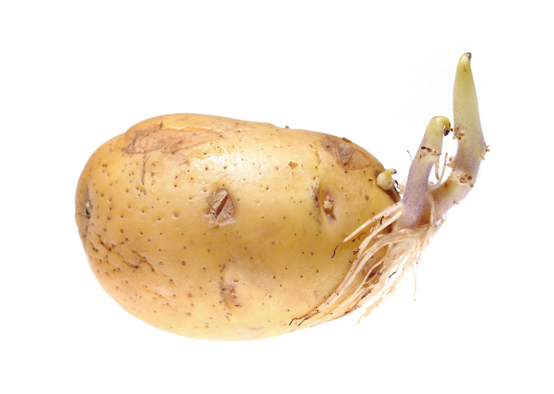
  Reproduction in flowering plants
some can reproduce both asexually and sexually
when the environmental conditions are favourable
reproduce asexually
produce large numbers of offspring in a short time
potato
(stem tuber)

Slide 2
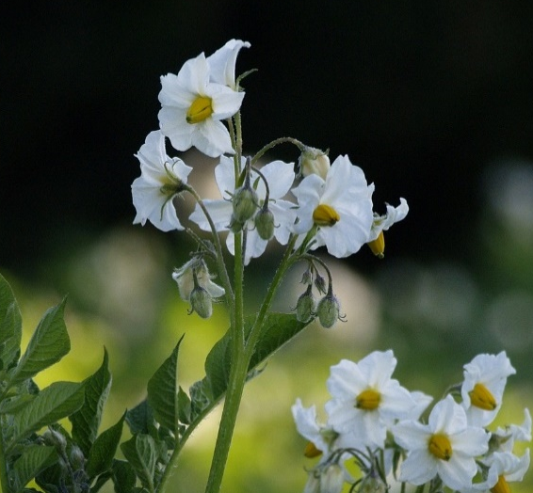
  Reproduction in flowering plants
some can reproduce both asexually and sexually
when the conditions become unfavourable or
the environment changes suddenly
reproduce sexually
produce offspring with genetic variation
survival chance of species increases
flowers of potato plants

Slide 3
  Comparisons between asexual and sexual reproduction in flowering plants
 | Asexual reproduction | Sexual reproduction
Rate
Faster
Slower
one parent plant can produce a large number of offspring under favourable conditions
two parents are involved
external agents are required

Slide 4
  Comparisons between asexual and sexual reproduction in flowering plants
 | Asexual reproduction | Sexual reproduction
Desirable characteristics
Inherited from the parent to
offspring
May not inherited

Slide 5
  Comparisons between asexual and sexual reproduction in flowering plants
 | Asexual reproduction | Sexual reproduction
Food reserves for offspring
Plenty
Limited
large amounts of food reserves available in storage organs
seeds only contain limited food reserves

Slide 6
  Comparisons between asexual and sexual reproduction in flowering plants
 | Asexual reproduction | Sexual reproduction
Wastage of resources
Smaller
Larger
resources and energy are needed to produce flowers and fruits
many seeds are wasted if conditions for germination are poor

Slide 7
  Comparisons between asexual and sexual reproduction in flowering plants
 | Asexual reproduction | Sexual reproduction
Genetic variation among offspring
No genetic variation
Exists
less able to adapt to environmental changes
allows species to adapt to environmental changes

Slide 8
  Comparisons between asexual and sexual reproduction in flowering plants
 | Asexual reproduction | Sexual reproduction
Over-crowding problem
May occur
Prevented
all offspring are near to parent plant
intense competition for resources
fruits and seeds are usually dispersed away from the parent plants

Slide 9
  Comparisons between asexual and sexual reproduction in flowering plants
 | Asexual reproduction | Sexual reproduction
Chance of disease transmission
Higher
Lower

Slide 10

Which of the following is/are advantage(s) for plants to carry out asexual reproduction?
(1) | The offspring can grow in a new habitat.
(2) | Diseases are less likely to be transmitted from the parent plant to the offspring.
(3) | Desirable characteristics of the parent are retained in the offspring.

Slide 11
Which of the following is/are advantage(s) for plants to carry out asexual reproduction?
A. | (3) only
B. | (1) and (2) only
C. | (1) and (3) only
D. | (2) and (3) only
A

Slide 12

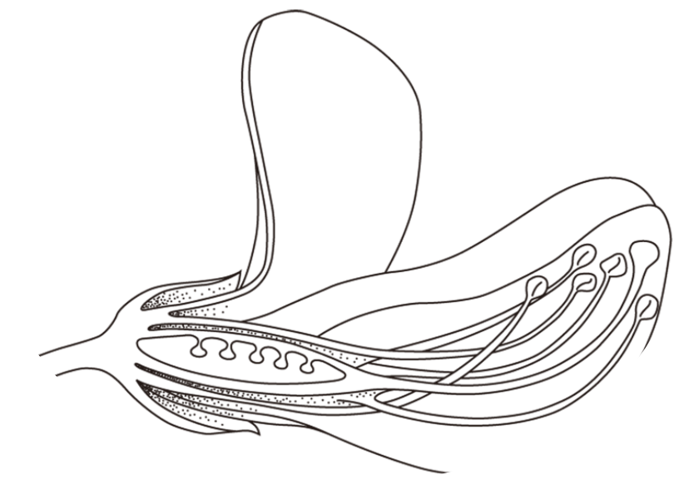
Worked example 13.1
Figure 1 shows a section through a pea flower.
C
B
D
A
E
F
Figure 1

Slide 13
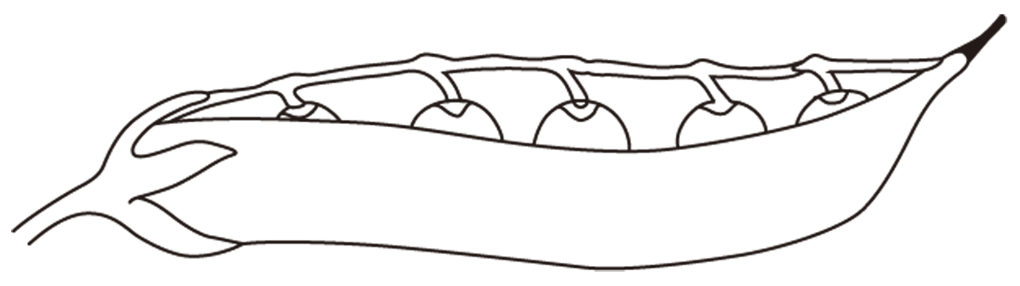
Worked example 13.1
Figure 2 shows the fruit of a pea plant.
seed
pea pod
Figure 2

Slide 14
Worked example 13.1
(a) What is the pollinating agent for pea plants? Support your answer with two observable features from Figure 1. (3 marks)
Insects (1)
Large petals (1)
Stigma or anthers lie within the flower (1)
Broad stigma (1)
(any two features of the above)

Slide 15


Worked example 13.1
(a) What is the pollinating agent for pea plants? Support your answer with two observable features from Figure 1. (3 marks)
As the question is asking for the ‘pollinating agent’, students who answered ‘insect pollination’ do not score the mark.

Slide 16
Worked example 13.1
(b) With reference to Figure 1, from which part of the flower does the seed develop? (1 mark)
Part A (1)

Slide 17
Worked example 13.1
(c) Are the seeds and the pea pod cells genetically identical? Explain your answer. (4 marks)
No. The seeds and the fruit pod are genetically different (1)
because cells in the fruit wall are formed from ovary wall of the parent plant only (1)

Slide 18
Worked example 13.1
(c) Are the seeds and the pea pod cells genetically identical? Explain your answer. (4 marks)
while cells in the seeds are developed from the zygote, (1)
which contains a combination of genetic materials from two parent plants. (1)

Slide 19
Worked example 13.1
(d) Give one advantage of reproduction with seeds over vegetative propagation. (1 mark)
The seeds can be dispersed some distance away from the parent plant, reducing competition for resources among offspring (1)
(or other acceptable answers)

